Slide 1
Prediction of Cardiovascular Disease Logistic Regression Model Development and Evaluation Machine Learning with R Model Presentation medical_data.csv
KIBIDI LERENCER| 01/04/2026 Chuka University: Center for Data Analytics and Modeling Registration No: CDAM/0047/2026 Instructor: LEC VICTOR WANDERA

Slide 2

Executive summary
The project entailed machine learning with R , it was aimed at training a Logistic Regression Model and a baseline glm model that will use the medical dataset to predict cases of CVD .The dataset was made up of 2500 observations and 16 variables, CVD being the target of this analysis.
The process involved Data Import and Exploration, Preprocessing,Partitioning,Model Training with trainControl,Model Evaluation and later Interpretation.
Key Insights:
1. The major predictors of CVD were found out to be:
Family History (OR=3.04) -Tripples the risk if present.
Glucose levels (OR=2.06)- Doubles the risk
Sleep hours (OR=0.45) - Reduces the risk by half
Smoking (OR=1.9)- Doubles the risk
Stress Levels (OR-1.8)-Doubles the risk
From this statistics it is safe to advice the general public to cut down sugar intake, get enough rest and quit smoking and relaxing as ways to prevent Cardivascular disease.

Slide 3
Executive summary
2. Data Imbalance
The dataset was highly imbalanced, with only ~10% (253)of patients having CVD out of the 2500. This significantly impacted model performance as it introduced bias making the model poor at identifying actual CVD cases (sensitivity of only 20%) regardles of its high overall accuracy of 90% at the default 0.5 threshold.
3.Clinical Insight
The default model is shaky for screening as it misses 80% of sick patients. By optimizing the classification threshold to 0.20, sensitivity improved to 64%, making the model more clinically useful for identifying at-risk individuals.

Slide 4
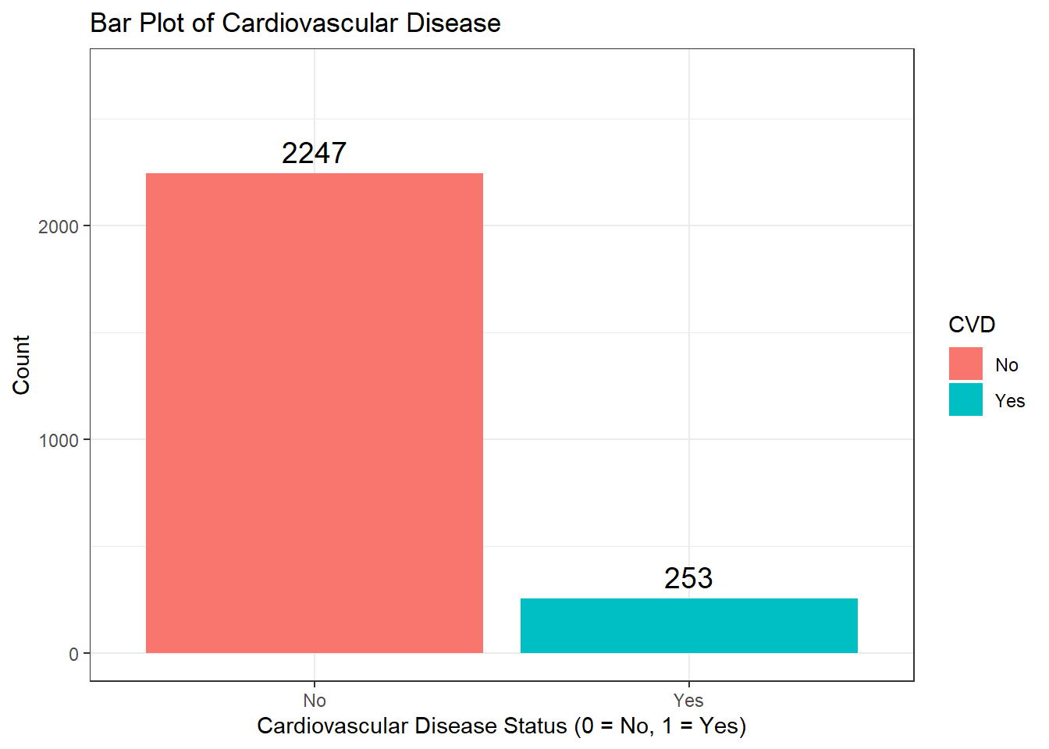
Bar plot of Target Variable
*shows severe class imbalance in data distribution
*No Cases 2247(89.9%)
*Yes Cases 253 (10.1%)

Slide 5

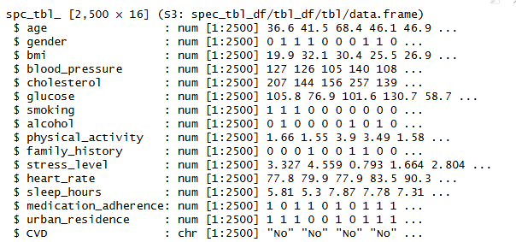


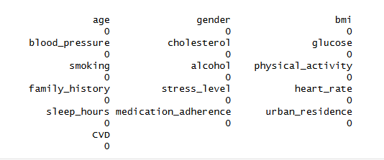
Data set Characteristics
* No missing values: imputation or deletion was necessary
*No duplicates
*15 variables numeric,6 hot encoded, 9-continous, and target character no/yes
*if missing data were present i would Handle missing by removal:
1. Sentive medical model
2.complete case analysis
3.use only verified pt data
* if there were more than 5%-impute

Slide 6
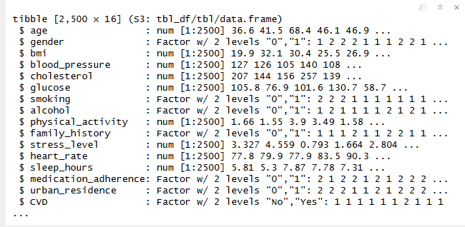
Data preprocessing results

Slide 7
Data partitioning
Total Dataset (2,500 patients)
├─────────────────────────────┐
│ │
▼ ▼
Training (70%) Testing (30%)
- 1,750 patients - 750 patients
- Used to teach the model - Used to evaluate performanc
Total count was 2500
*seed 2026
*split 70:30
train_set -1751, 16
test_set -749, 16
Data partitioning with stratified sampling enables model validation, preventing overfitting,Honest Performance Estimate,Detects Data Leakage,fair Model comparison and Selection and providing clinically reliable performance estimates
No Yes
0.8983438 0.1016562

Slide 8
Model training with train control
*variables used to train the model -CVD ~ age + gender + bmi + blood_pressure + cholesterol + glucose + smoking + alcohol + family_history + stress_level + sleep_hours + urban_residence,
*N/B: Physical activity was removed from the model due to computational instability, convergence failure and excessive run time
*It is worth noting that the logistic regression model outputs of both baseline model using base R glm() function and caret::train() with method "glm" gave same coefficients, AIC(875.53), deviance values (null deviance -1151.13) and same p values.
*The metric "Accuracy" was not in the result set. ROC will be used instead.
parameter | ROC | Sens | Spec | ROCSD | SensSD | SpecSD
Value | 0.835 | 0.990 | 0.213 | 0.048 | 0.003 | 0.051

Slide 9
Performance Metrics
Metric | Value | Grade | Interpretation
ROC (AUC) | 0.835 | Good | Model can distinguish between CVD and No CVD 83.5% of the time
Sensitivity | 0.990 | Excellent | Model correctly identifies 99% of CVD patients in training
Specificity | 0.213 | Poor | Model only correctly identifies 21% of healthy patients
Stability Assesment
Metric | SD | Interpretation
ROCSD (0.048) | 4.8% | AUC varies little across folds → Stable
SensSD (0.003) | 0.3% | Sensitivity almost identical across folds → Very stable
SpecSD (0.051) | 5.1% | Specificity varies moderately → Acceptable

Slide 10
Predict class and probabilities on the test
Metric | Value | Grade | What It Means
Accuracy | 89.45% | Good | Overall, 9 out of 10 predictions are correct
Sensitivity | 13.33% | Poor | Only 1 in 7 sick patients detected
Specificity | 97.92% | Excellent | 98% of healthy patients correctly identified
Kappa | 0.1613 | Poor | Slightly better than random chance
On the test set of 749 patients, the model achieved 89.5% accuracy but only 13.3% sensitivity, missing 65 of 75 actual CVD cases. The Kappa of 0.16 indicates only slight agreement beyond chance, and the p-value (0.71) confirms the model is not statistically better than simply predicting 'No CVD' for all patients. This poor sensitivity makes the model clinically unacceptable at the default threshold, necessitating threshold optimization

Slide 11
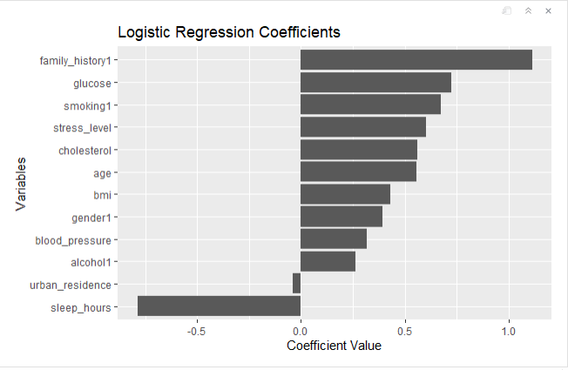
Logistic Regression Coefficient plot
*Having a family history of CVD increases the log-odds by 1.113 units. This is the strongest risk factor in the model
*For every 1-unit increase in glucose (mg/dL), the log-odds of CVD increases by 0.725
*Smokers have 0.676 higher log-odds of CVD compared to non-smokers.
*For every 1-point increase on the stress scale, log-odds increase by 0.602
*For every additional hour of sleep, the log-odds of CVD drops by 0.788.

Slide 12
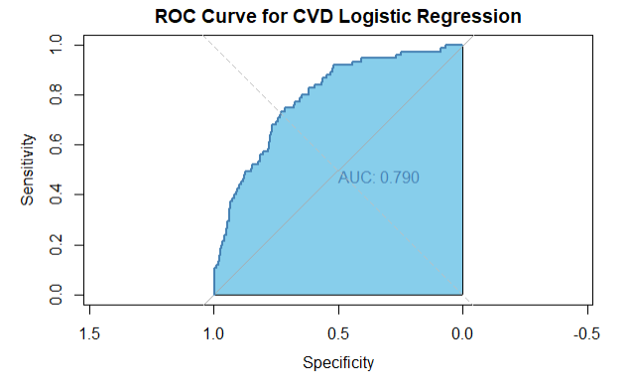
Plot of area under the curve
Fair to Good discrimination │
Sick ranked higher 79% of the time
Still useful clinically
*AUC = 0.79* model is good at ranking risk, even though sensitivity is poor at the default threshold.
Threshold adjustment can improve sensitivity while maintaining reasonable specificity.

Slide 13
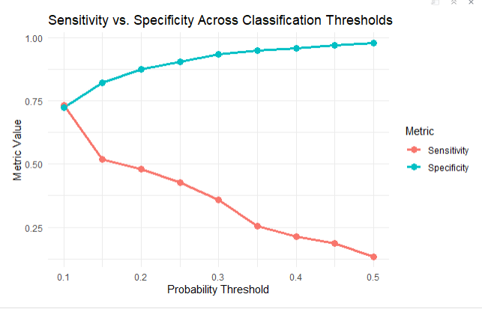
Threshold Optimization & Trade off
The threshold optimization plot reveals the classic trade-off
As the threshold increases from 0.10 to 0.50, sensitivity drops from 73% to 13% while specificity rises from 72% to 98%
The optimal clinical threshold is 0.20, balancing sensitivity (48%) and specificity (88%) to prioritize detecting sick patients for screening purposes.

Slide 14
Old ratios in context of CVD risk
╔══════════════════════════════════════════ ODDS RATIOS SUMMARY ║
STRONGEST RISK FACTORS (OR > 1.5)
• Family History 3.04 (TRIPLES risk) ★★★★★
• Glucose 2.06 (DOUBLES risk) ★★★★
• Smoking 1.97 (DOUBLES risk) ★★★★
• Stress Level 1.83 (83% increase) ★★★★
• Age 1.75 (75% increase) ★★★
• Cholesterol 1.75 (75% increase) ★★★
• BMI 1.54 (54% increase) ★★★
• Gender (Male) 1.48 (48% increase) ★★
WEAKER RISK FACTORS (OR 1.0 - 1.5)
• Blood Pressure 1.38 (38% increase) ★ • Alcohol 1.30 (30% increase) (not significant) ║
PROTECTIVE FACTORS (OR < 1)
• Sleep Hours 0.45 (55% REDUCTION) ★★★★★
• Urban Residence 0.96 (4% reduction) (not significant)
Family history triples CVD risk (OR=3.04), while glucose and smoking double it (OR≈2.0). Sleep is the strongest protective factor, reducing risk by 55% per additional hour (OR=0.45)
promoting adequate sleep could be a powerful public health intervention for CVD prevention

Slide 15
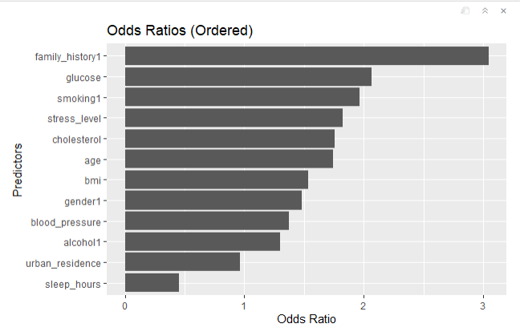
Significant predictors

Slide 16
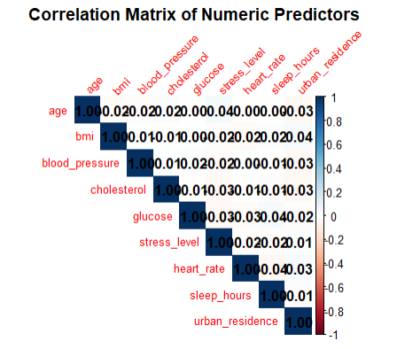
Correlation Matrix

Slide 17
Visual: Actionable Factors Table
GET MORE SLEEP → 7-8 hours nightly reduces CVD risk by 55%
CONTROL YOUR BLOOD SUGAR; Cut sugar and refined carb, Risk drops by 50%
QUIT SMOKING→Nearly doubles your risk (97% increase)
REDUCE STRESS→ 83% higher risk with high stress; meditation, exercise, or counseling
LOWER CHOLESTEROL→ 75% higher risk with high cholesterol→ Diet + exercise
LOSE EXCESS WEIGHT→ 54% higher risk with high BMI→ 10% weight loss = significant risk reduction
KNOW YOUR FAMILY HISTORY → Triples your risk (3x)→ Can't change it → Screening EARLY

Slide 18
Model Limitations
1. Class Imbalance-less sick counr
2. Linearity Assumption-nonlinear effect
3. Multicollinearity-mild correlation
4. Data Quality-outliers
5. Generalizability-one source
6. Omitted Variables ie physical activity
7. Measurement Error-self reported varables is stresslevels

Slide 19
Potential Biases
Bias Type | Severity | Can Fix?
Class Imbalance | HIGH | Yes (SMOTE, weighting)
Omitted Variable | HIGH | Partial (collect more data)
Measurement Bias | MEDIUM | Partial (objective measures)
Sampling Bias | MEDIUM | Yes (external validation)
Data Entry Bias | LOW | Yes (data cleaning)
Overfitting | LOW | Yes (external validation)
Confounding | MEDIUM | Partial (more variables)
Threshold Bias | HIGH | Yes (optimize threshold)
Algorithm Bias | MEDIUM | Yes (try other models)

Slide 20
Clinical Impact Summary
strengths
Excellent specificity (98%)-Very few false alarms – healthy patients rarely told they have CVD
Good ranking ability (AUC 0.79)-Effectively identifies who needs closer monitoring
Identifies key risk factors-Family history, glucose, smoking, stress, sleep
Fast computation-Can be deployed in real-time clinical settings
weakness
Poor sensitivity (13% at default threshold)-Misses 87% of actual CVD patients
Class imbalance bias-Model prefers predicting "healthy"
Physical activity excluded-Lost a potentially important protective factor

Slide 21
THANK YOU

